Slide 1
Travel and Tourism
Navigating the pandemic -- year two
JEREMY L. SAGE, Ph.D.
ECONOMIST & INTERIM DIRECTOR
INSTITUTE FOR TOURISM AND RECREATION RESEARCH
ASSOCIATE RESEARCH PROFESSOR
DEPARTMENT OF GEOGRAPHY
FRANKE COLLEGE OF FORESTRY AND CONSERVATION
In the aboriginal territories of the Salish and Kalispel people

Slide 2
U.S. Travel & Hospitality
Travel, tourism, and allied industries have been some of the hardest hit industries in the U.S. and worldwide

Slide 3
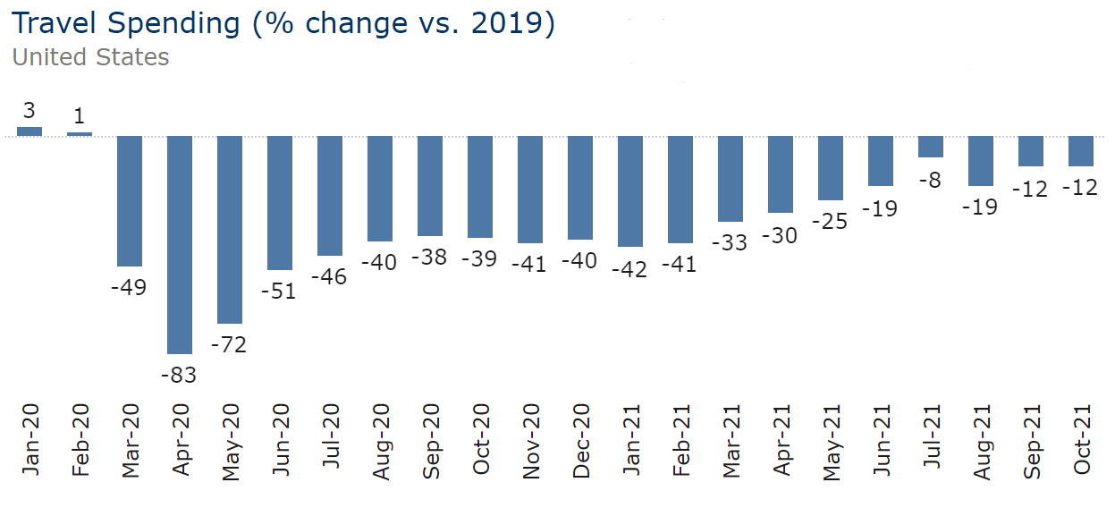
U.S. Travel & Hospitality Current Insights

Slide 4
U.S. Travel & Hospitality Current Insights
Auto trips and Short Term Rentals outperforming the other travel indicators.

Slide 5
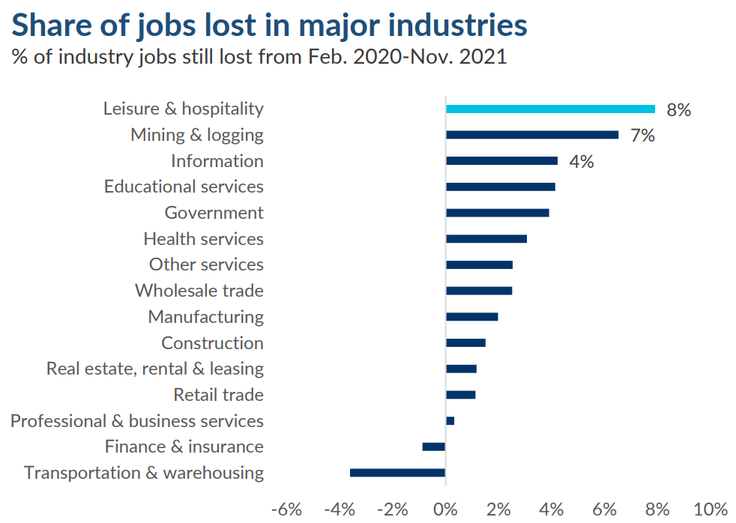
U.S. Travel & Hospitality Work Force
As of November, 2021, L&H jobs remain 8% below February 2020 levels
Source: U.S. Travel Association and Tourism Economics; BLS

Slide 6
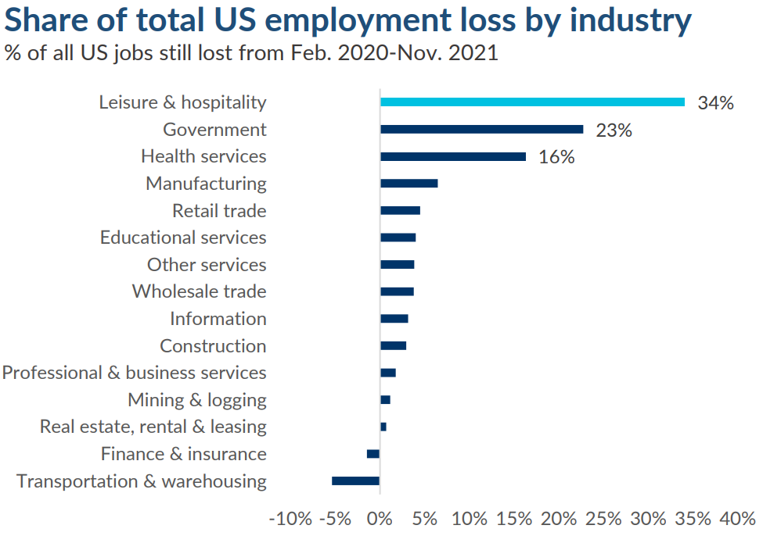
U.S. Travel & Hospitality Work Force
As of November, 2021, L&H jobs represent 34% of job losses
Source: U.S. Travel Association and Tourism Economics; BLS

Slide 7
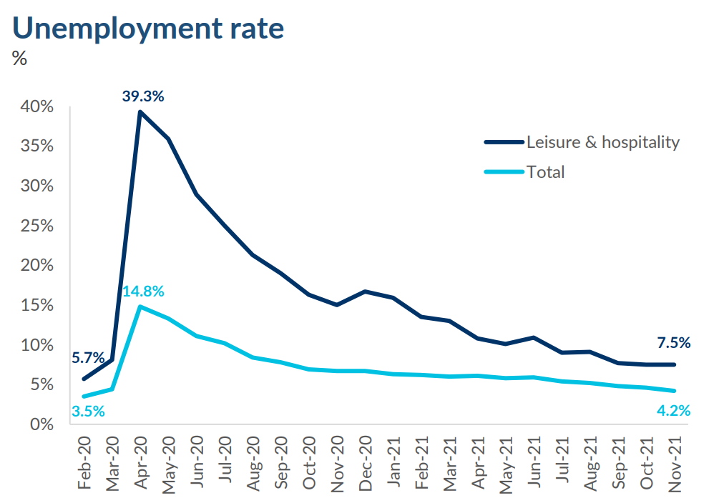
U.S. Travel & Hospitality Work Force
As of November, 2021, L&H unemployment remains well above totals
Source: U.S. Travel Association and Tourism Economics; BLS

Slide 8
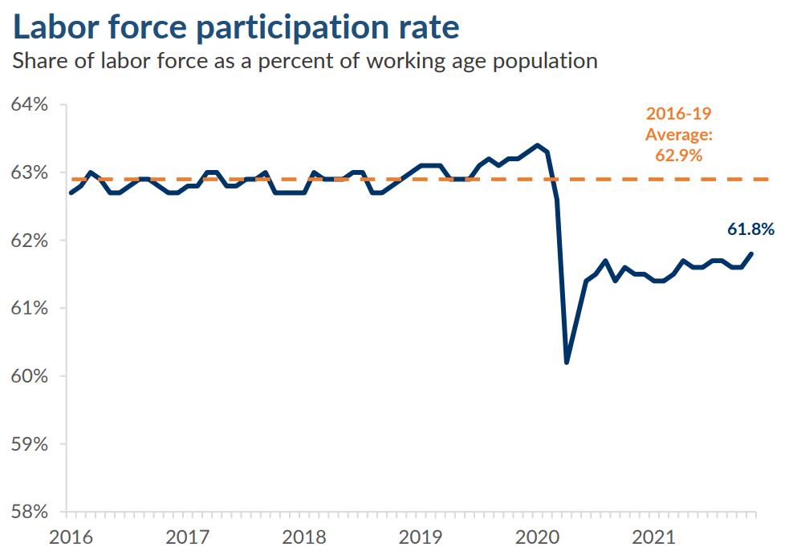
U.S. Travel & Hospitality Work Force
Labor participation remains below previous averages
Source: U.S. Travel Association and Tourism Economics; BLS

Slide 9
Montana Travel
Following national trends?
Or finding its own way?

Slide 10
Montana Travel
Source: U.S. Travel Association and Tourism Economics

Slide 11
Lodging Facility Use Tax Collection
(Bed Tax)
2021 Compared to Expected Normal:
Spring = 34% higher
Summer = 23% higher
Source: Montana Department of Commerce

Slide 12
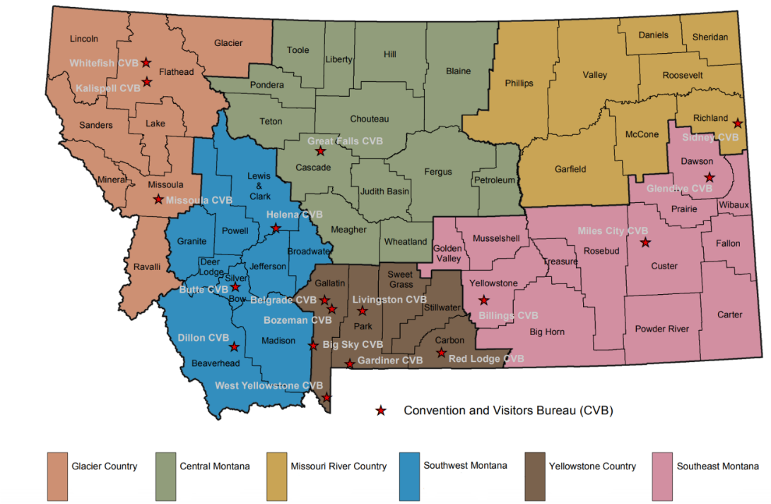
Lodging Facility Use Tax Collection
Quarterly Changes 2020 & 2021
Q1 | Q2 | Q3 | Q4 | Total
-1% | -53% | -11% | +13% | -18%
+57% | +228% | +56% |  | +84%
Q1 | Q2 | Q3 | Q4 | Total
-8% | -39% | -21% | -4% | -20%
-3% | +67% | +12% |  | +24%
Q1 | Q2 | Q3 | Q4 | Total
-9% | -53% | -37% | -26% | -34%
-8% | +124% | +81% |  | +62%
Period
2020
2021
Q1 | Q2 | Q3 | Q4 | Total
-17% | -57% | -16% | -17% | -28%
+17% | +188% | +69% |  | +82%
Q1 | Q2 | Q3 | Q4 | Total
-18% | -53% | -24% | -23% | -30%
+3% | +148% | +64% |  | +66%
Q1 | Q2 | Q3 | Q4 | Total
-2% | -62% | -4% | +17% | -15%
+30% | +292% | +52% |  | +77%
Source: Montana Department of Commerce

Slide 13
Lodging Facility Use Tax Collection
Quarterly Changes 2020 & 2021
Occupancy: 21/19
82%/79% - July
79%/75% - June
ADR: 21/19
$180/$138 – July
$152/$125 – June
Q1 | Q2 | Q3 | Q4 | Total
-1% | -53% | -11% | +13% | -18%
+57% | +228% | +56% |  | +84%
Q1 | Q2 | Q3 | Q4 | Total
-8% | -39% | -21% | -4% | -20%
-3% | +67% | +12% |  | +24%
Q1 | Q2 | Q3 | Q4 | Total
-9% | -53% | -37% | -26% | -34%
-8% | +124% | +81% |  | +62%
Q1 | Q2 | Q3 | Q4 | Total
-17% | -57% | -16% | -17% | -28%
+17% | +188% | +69% |  | +82%
Q1 | Q2 | Q3 | Q4 | Total
-18% | -53% | -24% | -23% | -30%
+3% | +148% | +64% |  | +66%
Q1 | Q2 | Q3 | Q4 | Total
-2% | -62% | -4% | +17% | -15%
+30% | +292% | +52% |  | +77%
Period
2020
2021
Source: Montana Department of Commerce

Slide 14
Yellowstone Recreation Visits
Highest on Record
2021 has set annual visitation record
Source: National Park Service

Slide 15
Glacier Recreation Visits
Highest on Record
Highest West Gate Volume
Source: National Park Service
2021 may set annual visitation record

Slide 16
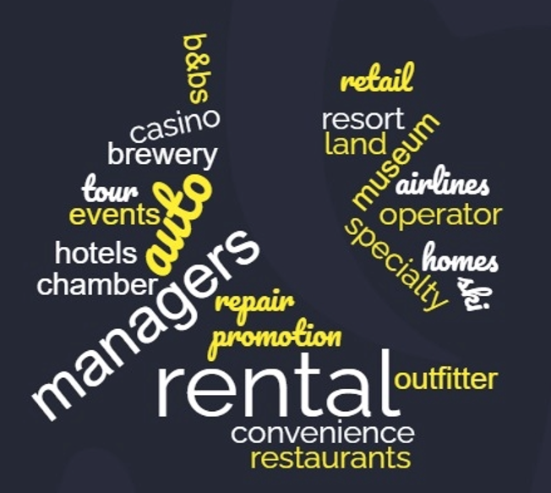
Montana Perceptions on Labor in Tourism & Recreation
Surveyed more than 400 business owners, managers, and partners in travel and tourism throughout Montana.
Employees | Respondents
1 to 4 | 210
5 to 9 | 62
10 to 19 | 61
20 to 49 | 37
50 to 99 | 26
More than 99 | 21
Source: Institute for Tourism and Recreation Research

Slide 17
Montana Tourism & Recreation - Labor
Average Change +17.7%
Question: How did your 2021 customer volume compare to 2019
Average Sales Change +20.7%
Source: Institute for Tourism and Recreation Research

Slide 18
Montana Tourism & Recreation - Labor
Average Change +31.6%
Question: How did your 2021 customer volume compare to 2020
Average Sales Change +35.7%
Source: Institute for Tourism and Recreation Research

Slide 19
Montana Tourism & Recreation - Labor
Question: Would you consider your business/agency to be currently understaffed?
Percent affirming they are understaffed
Positions most likely to be understaffed:
Customer/Public Facing (Waitstaff, front desk, guides)
Back of house (cooks, support staff, maintenance)
Source: Institute for Tourism and Recreation Research

Slide 20
Montana Tourism & Recreation - Labor
Question: As a result of being understaffed, what actions have been taken at your business/agency in 2021?
Source: Institute for Tourism and Recreation Research

Slide 21
Montana Tourism & Recreation - Labor
Question: As a result of being understaffed, what actions have been taken at your business/agency to entice potential applicants?
Percent affirming they have instituted the practice
Source: Institute for Tourism and Recreation Research

Slide 22
Montana Tourism & Recreation - Labor
Question: In your opinion, please rate how important the following attributes are to former employees who chose leave (or not return after furlough/layoff) your business
Rated on a scale of Not at all important (1) to Extremely Important (5)
Source: Institute for Tourism and Recreation Research

Slide 23
Montana Tourism & Recreation - Labor
Question: Since the start of the pandemic, have you left (or do you have coworkers that have left) the service and hospitality industry? If so, why?
“Honestly, COVID just made the decision to leave the service industry ‘valid’ and socially acceptable. Service industry workers left because not only were they being treated as sub-human, paid little nothing, given no support, pushed to their limits, but there was also a pandemic exacerbating the situation workers were already in. The last straw was COVID and the complete disregard for workers health and the belittling by corporations of any concerns workers had for their own wellbeing. The idea of leaving has always been in their mind, but COVID made it easier/gives a real reason to leave a soul crushing job.”
Source: UM Student Project: Parks Tourism & Recreation Management - Mikala Itrich, Philip Buttschardt, William Thomas, Victoria Bloomgren, Rebekah Ficek

Slide 24
Montana Tourism & Recreation - Labor
Question: Since the start of the pandemic, have you left (or do you have coworkers that have left) the service and hospitality industry? If so, why?
“Wages had stayed the same even though there was more work. Inconsistent hours with lower pay.”
“Did not want the chance of being exposed to so many people in a day. Immune-compromised people felt unable to continue their jobs. Feeling unsafe.”
“Increased hostility in customer interactions. Undervalued by employers and customers. Degrading nature of hospitality work. Abusive environment. Rude customers.”
“Understaffing left employees feeling helpless. Stress increased without enough employees.”
“It was easier to receive more money under unemployment than it was to stay in a negative workplace.”
“Less security in the workplace. Slow business. Higher expectations.”
“Other employees, as well as our boss, took their stress out on us, increasing our stress.”
Source: UM Student Project: Parks Tourism & Recreation Management - Mikala Itrich, Philip Buttschardt, William Thomas, Victoria Bloomgren, Rebekah Ficek

Slide 25
Moving Forward
Source: US Travel Association

Slide 26
Montana Tourism & Recreation – 2022 Outlook
Question: How do you expect your 2022 customer volume to compare to 2021
Source: Institute for Tourism and Recreation Research

Slide 27
Montana Tourism & Recreation – 2022 Outlook
Question: Looking to 2022, how concerned are you about the following, as they may impact your business/agency:
(1) Not at all concerned, (2) Somewhat Concerned, (3) Extremely Concerned
Mean
2.25
2.24
2.23
2.07
2.03
2.02
2.02
1.99
1.99
1.93
1.91
1.34
Source: Institute for Tourism and Recreation Research

Slide 28
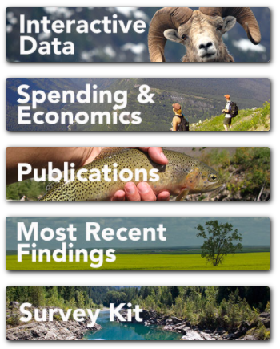
Thank You
For all information from the Institute for Tourism and Recreation Research, please see: itrr.umt.edu
jeremy.sage@umontana.edu

